Slide 1
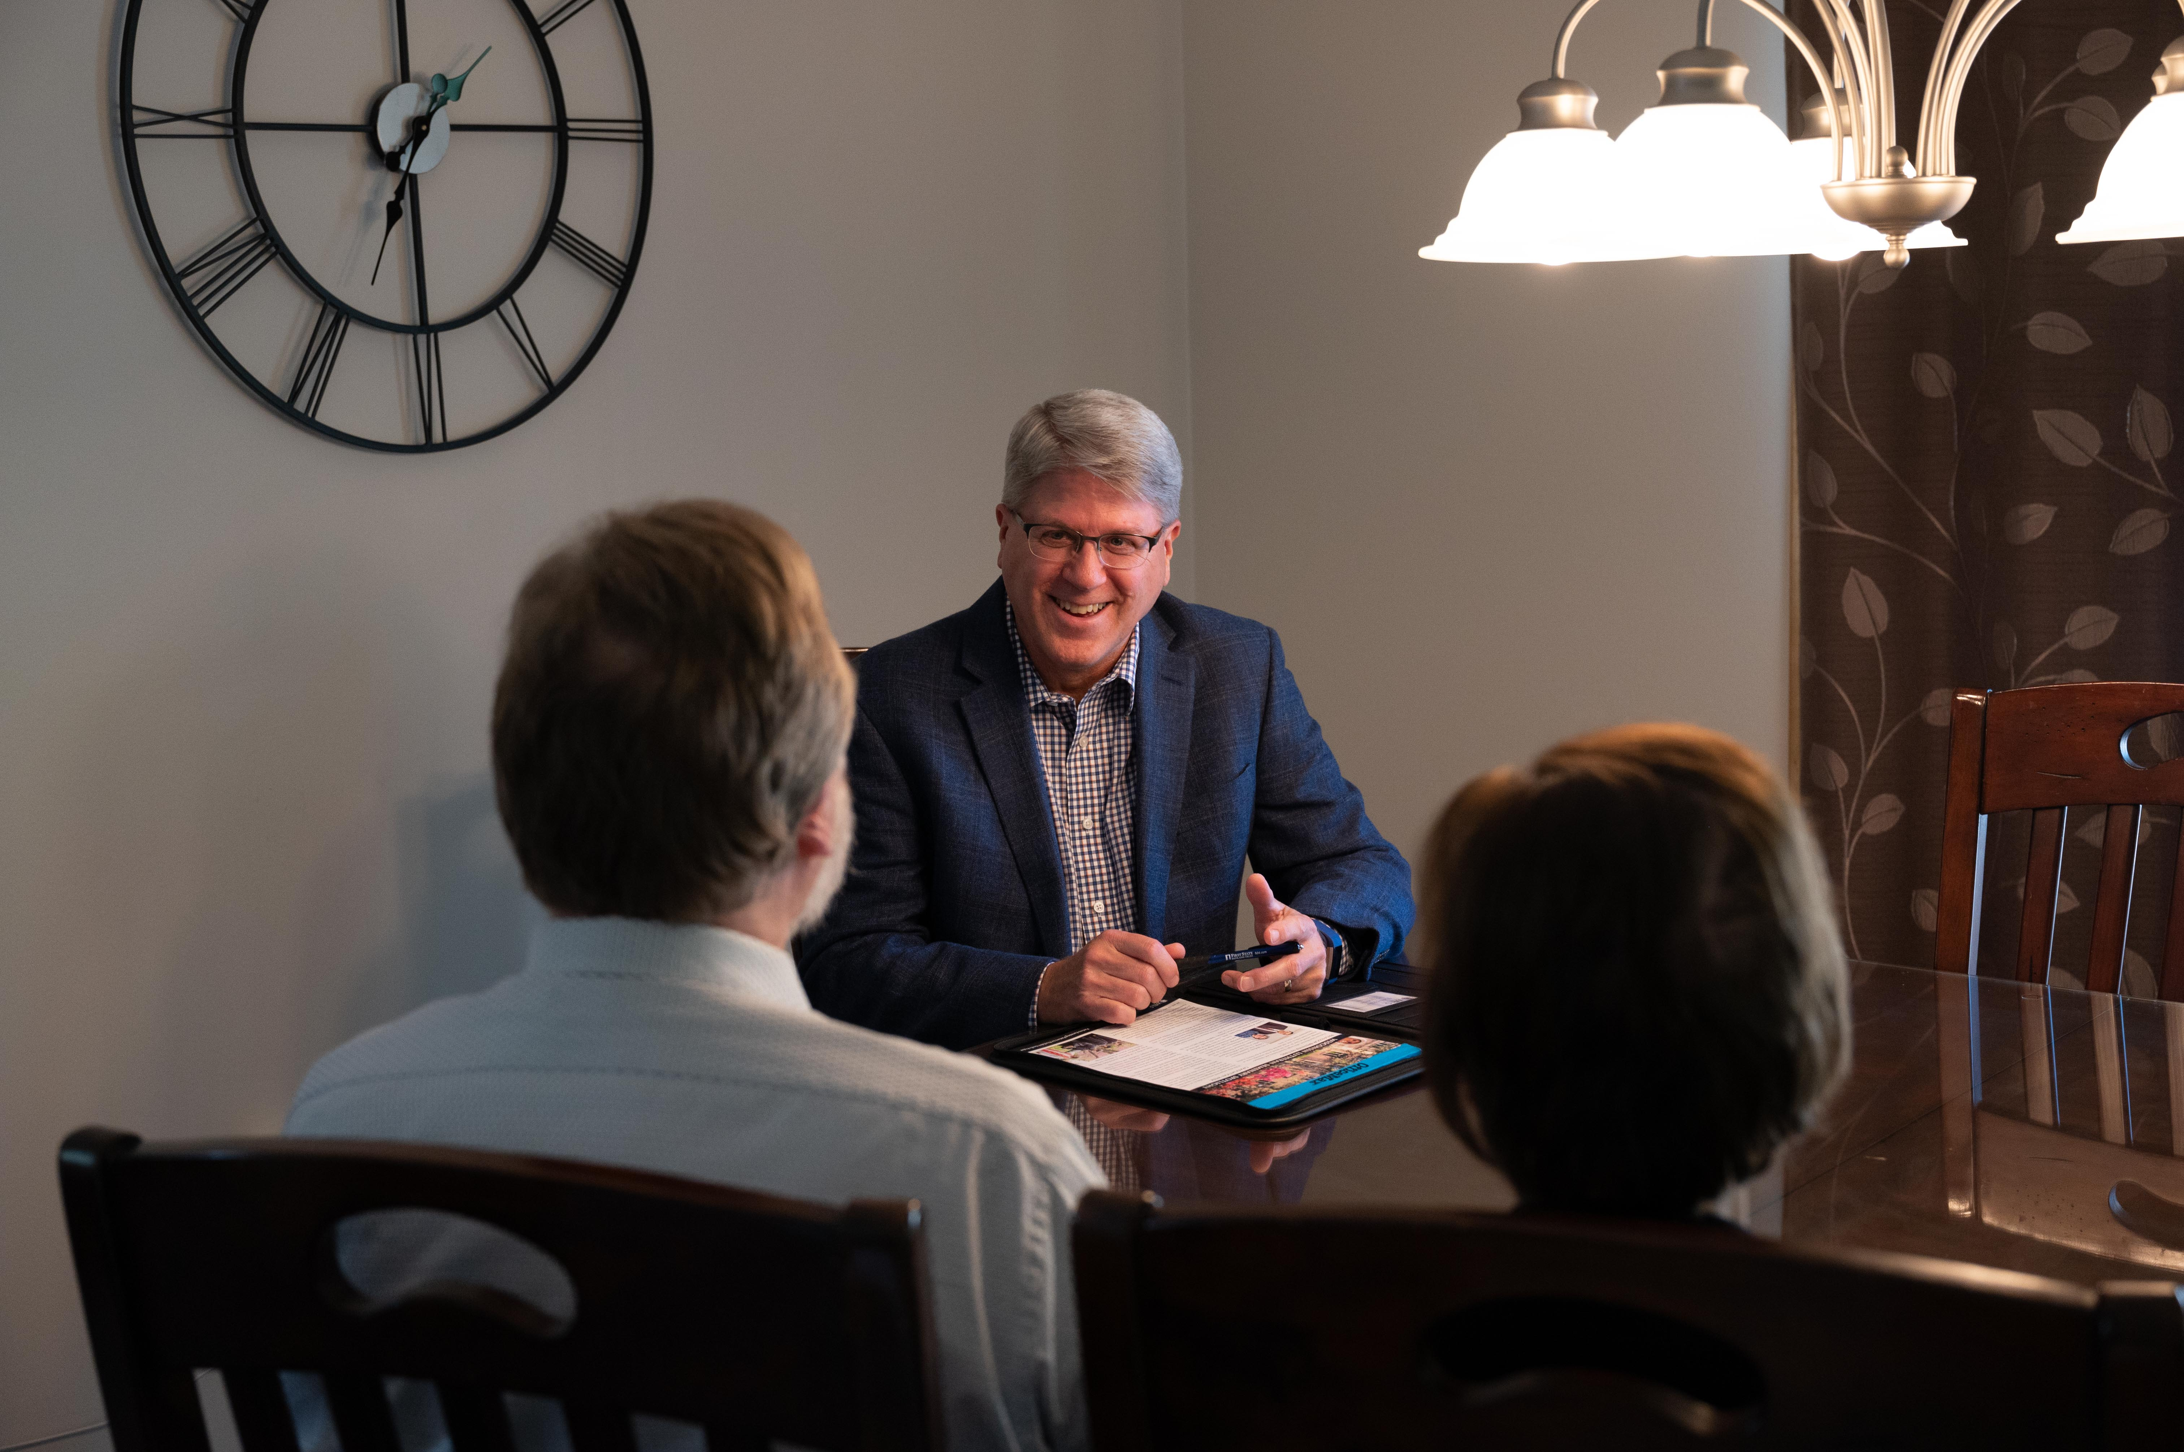
Congregational Planned Giving Program
Excel in this grace of giving . . . For you know the grace
of our Lord Jesus Christ. (2 Corinthians 8:7,9)
[Presenter Name, Job Title]

Slide 2
Topics Covered
Introduction
Quick Start to a Congregational Planned Giving Program
Quick Start to a Congregational Endowment Fund through WELS Foundation
Setting Up a Congregational Planned Giving Committee
Administering a Congregational Endowment Fund
WELS Organizations that Can Help You

Slide 3
Introduction
The Lord is the planned Giver.
One of the ways we respond is by planning our offerings to the Lord.
There is much room for growth in planned giving.
The purpose of a planned giving program:
Educating
Encouraging
Enlisting
Exciting

Slide 4
Scriptural Basis for Giving
1. God owns everyone and everything.
The earth is the LORD’s, and everything in it, the world, and all who live in it. Psalm 24:1
2. By grace God supplies all our needs.
My God will meet all your needs according to the riches of his glory in Christ Jesus. Philippians 4:19
3. God prompts our thankful response.
Whatever you do, whether in word or deed, do it all in the name of the Lord Jesus, giving thanks to God the Father through him. Colossians 3:17

Slide 5
Scriptural Basis for Giving
4. God graciously tasks us with managing his blessings.
[The kingdom of heaven] will be like a man going on a journey, who called his servants and entrusted his wealth to them. Matthew 25:14
5. God encourages us to joyfully give our offerings out of love for Christ.
For you know the grace of our Lord Jesus Christ . . . Each of you should give what you have decided in his heart to give, not reluctantly or under compulsion, for God loves a cheerful giver. 2 Corinthians 8:9; 9:7

Slide 6
Quick Start to a Congregational Planned Giving Program
Go to wels.net/plannedgivingprogram to access the following WELS planned giving resources.
Publications Different Ways to Make Planned Gifts and Estate Planning for the Christian Steward
WELS Foundation and Grace of Giving newsletters, which include planned giving articles
Stewardship by the Lectionary devotionals
Links to the WELS Foundation website and a directory of Christian giving counselors

Slide 7
Quick Start to a Congregational Planned Giving Program
2. Consider all available communication tools in your congregation for sharing planned giving information and encouragement:
Print pieces
Bulletins
Newsletters
Mailings
Phone calls, text messages
Personal visits
Internet
Digital displays
Bulletin board
Announcements
Promotional items
Special events

Slide 8
Quick Start to a Congregational Planned Giving Program
3. Consider a one-year strategy that incorporates these communication tools. See the manual for a sample strategy.
4. Follow your congregation’s gift administration policies.
Appropriate gift acknowledgment
Respecting confidentiality
If your congregation doesn’t have a gift acceptance policy, consider establishing one. Find a sample policy at wels.net/plannedgivingprogram.
5. Provide assistance with gifts. Utilize WELS Christian giving counselors.

Slide 9
Quick Start to a Congregational Planned Giving Program
6. Celebrate gifts! Some of the best publicity for planned giving is actual gifts!

Slide 10
Quick Start to a Congregational Endowment Fund through WELS Foundation
Why an endowment?
Setting a clear purpose for the fund
Examples of how churches are using endowments
Addressing concerns about endowments

Slide 11
Quick Start to a Congregational Endowment Fund through WELS Foundation
A donor or group of donors can establish a congregational endowment through WELS Foundation.
WELS Foundation provides the necessary reporting and administration.
A minimum of $25,000 is needed to start a congregational endowment. Once established, additional gifts may be added at any time.
Distributions are generally made to the congregation in late July.

Slide 12
Quick Start to a Congregational Endowment Fund through WELS Foundation
Promote your congregational endowment fund.
Celebrate gifts and distributions!

Slide 13
Setting Up a Congregational Planned Giving Committee
Purpose
Communicates to the congregation the opportunity to make planned gifts to the Lord
Serves as the initial contact for interested members
May work to set up and provide administration for an endowment fund

Slide 14
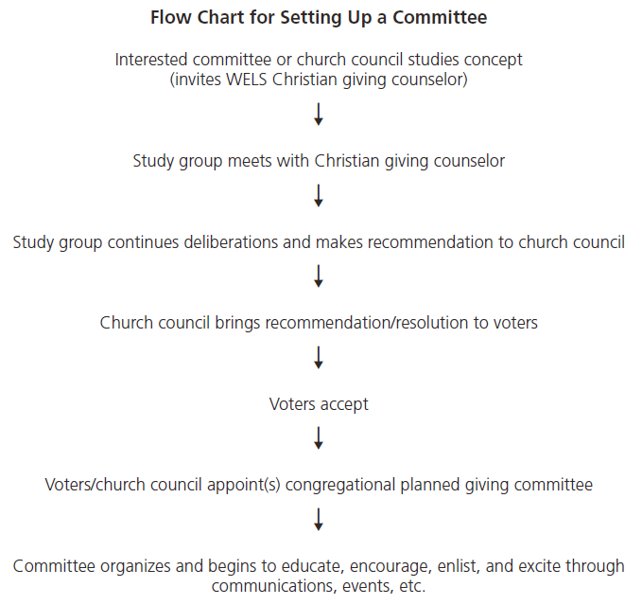
Setting Up a Congregational Planned Giving Committee

Slide 15
Setting Up a Congregational Planned Giving Committee
Building the committee
The committee should be made up of faithful members who are generous stewards and advocates of faithful stewardship.
Consider skills, capabilities, and interests. Skills of one or more committee members could include verbal and written communication, leadership, attention to detail, background in accounting, and relating well to one or more of the constituencies in the congregation.
Follow the standards of your congregation for the size of the committee and length of terms.

Slide 16
Setting Up a Congregational Planned Giving Committee
Special issues
The church council and the planned giving committee
Potential conflicts of interest

Slide 17
Setting Up a Congregational Planned Giving Committee
Administrative Tips
Possibly set up a special gifts committee to advise regarding the acceptance of gifts that are offered with conditions, and gifts of property other than cash or negotiable securities. Find a sample gift acceptance policy at wels.net/plannedgivingprogram.
Another option: assign a financial secretary or utilize another financial officer in the congregation.

Slide 18
Setting Up a Congregational Planned Giving Committee
Asking for gifts
Identify
Prepare
Call
Visit
Ask
Follow up

Slide 19
Administering a Congregational Endowment Fund
Set a clear purpose for the fund.
Two common types of endowments:
True endowment
Quasi-endowment
It is recommended that the accounting and investing of true endowment funds and quasi-endowment funds be done separately.

Slide 20
Administering a Congregational Endowment Fund
Establishing the endowment fund
Use congregational bylaws or a gift agreement. Templates are available at wels.net/plannedgivingprogram.
Consult with a legal advisor.
Endowment administration
Endowment funds are a matter of state law.
Nearly all states have adopted the Uniform Prudent Management of Institutional Funds Act (UPMIFA).
Consult your local attorney.

Slide 21
Administering a Congregational Endowment Fund
Investing
A number of congregations utilize the portfolios of WELS Investment Funds.
See the manual for investing considerations from UPMIFA and WELS Foundation’s Investment Policy for Permanently Restricted Funds.
Distributions
A prudent policy distributes a generous, predictable income stream that will increase over time to offset the long-term effects of inflation.
A common method is to distribute a certain percentage of the market value of the endowment fund each year.
The manual also includes WELS Foundation’s Expenditure Policy for Permanently Restricted Funds.

Slide 22
Administering a Congregational Endowment Fund
Reporting: The planned giving committee should provide an annual report to the congregation detailing
Investment gain and loss
Distributions and additions
Any charges to the fund

Slide 23
WELS Organizations that Can Help You
WELS Ministry of Christian Giving
WELS Foundation
WELS Investment Funds
WELS Church Extension Fund

Slide 24
Thank you!
WELS Ministry of Christian Giving
wels.net/plannedgivingprogram
E-mail: mcg@wels.net
Phone: 800-827-5482

